Slide 1

Registration
Team 8027

Slide 2
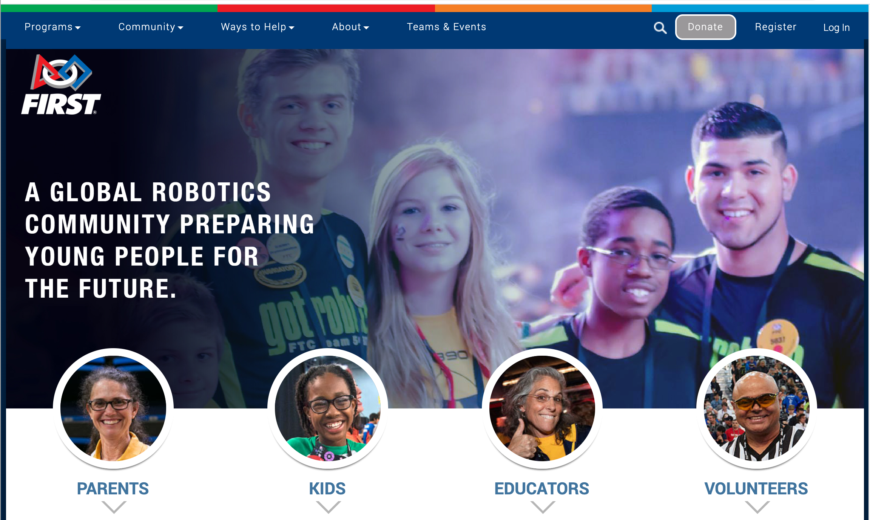
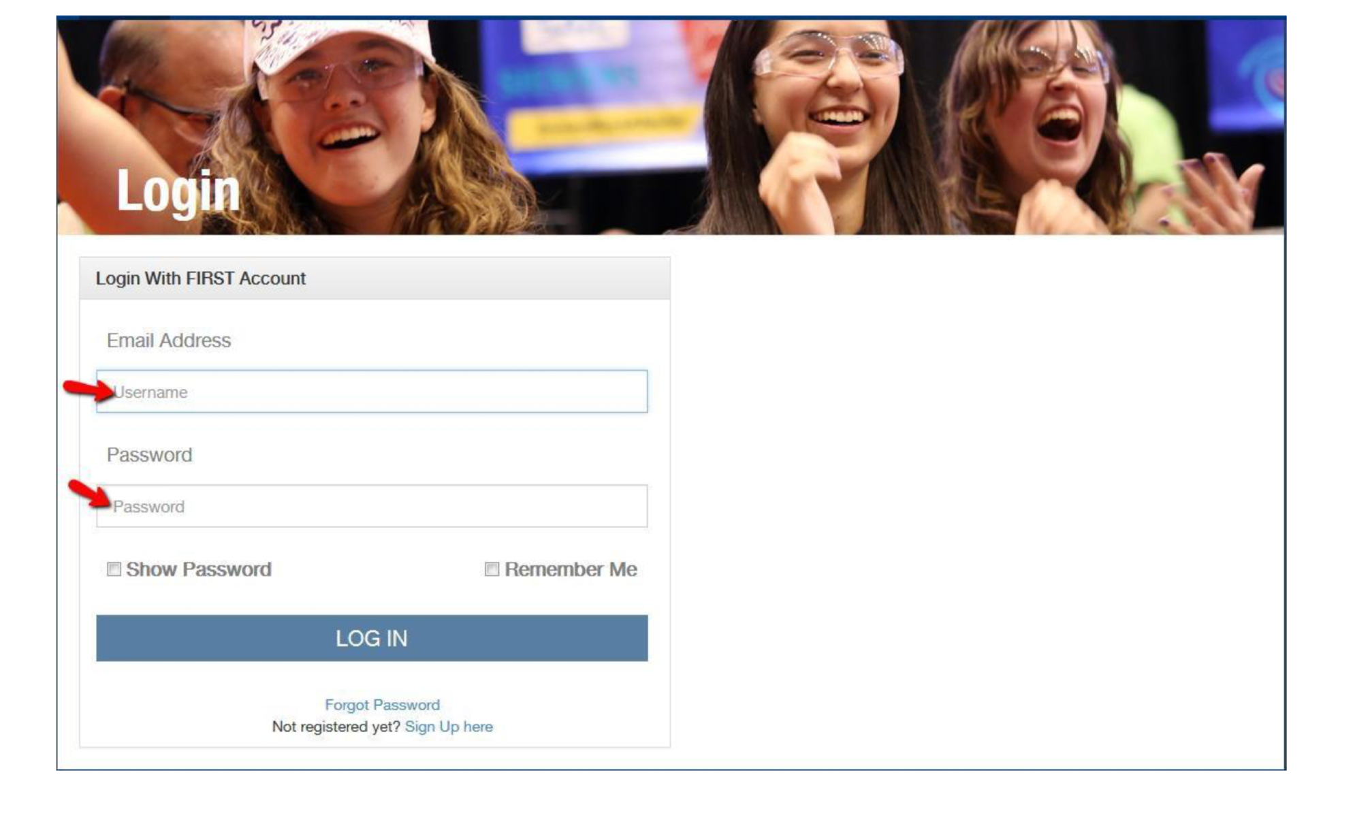
STEP 1: Pre-Register a Team
FIRST Registration opens in May on your FIRST Inspires Dashboard (https://www.firstinspires.org/), shortly after World Championships
When you register a FIRST Robotics Competition Team, you will be assigned a temporary team number
You do not have to pay anything at that time
Make sure that your adult coaches complete the Youth Protection (YPP) screening

Slide 3
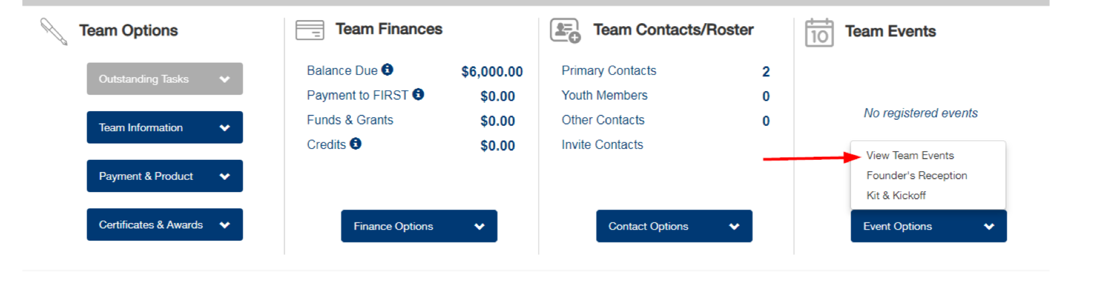
Step 2: Event Registration
In mid-September, teams who have completed the pre-registration process can select events for their first Regional or District event.
You must meet the following criteria:
Two adult coaches with completed Dashboard profiles and completed Youth Protection Screenings
Completed Team Profile
You do not need to pay for your registration prior to selecting events. Payment is due in mid-November for the first event.
You determine the preference order and you can add as many events as you like to your preference list, but will only be assigned to one event in the end
Assignments are based on a lottery system. Each team is assigned a random number and then their request is fulfilled from low to high.
[Rookie Tip] When you are accepted to your first event, a rookie team will get assigned your permanent team number

Slide 4
Step 3: Second Event Registration
Teams who want to attend a second event can register in mid-October
The process is the same as the first event
However, each team’s request is fulfilled from high to low based on their random number.
You do not pay for the event when you register. Payment for this second event is due at the end of January.
[Rookie Tip] Going to two events can be useful. It gives the students and mentors an opportunity to learn and iterate. However, it does add another $4000 to your budget.

Slide 5
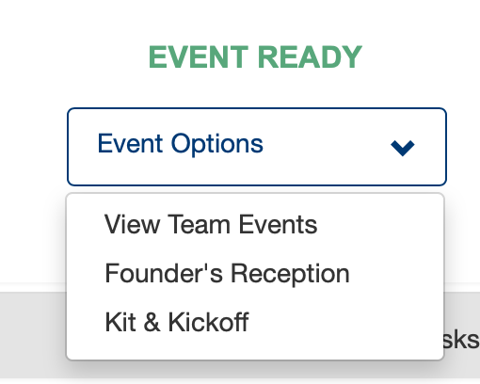
Step 4: Kit and Kickoff Registration
Teams receive a kit of parts
If you attend a local kickoff event, you can arrange to have this kit delivered there for you to collect in person
If not, you can arrange to have them shipped to you for a fee
This registration also appears on the Dashboard

Slide 6
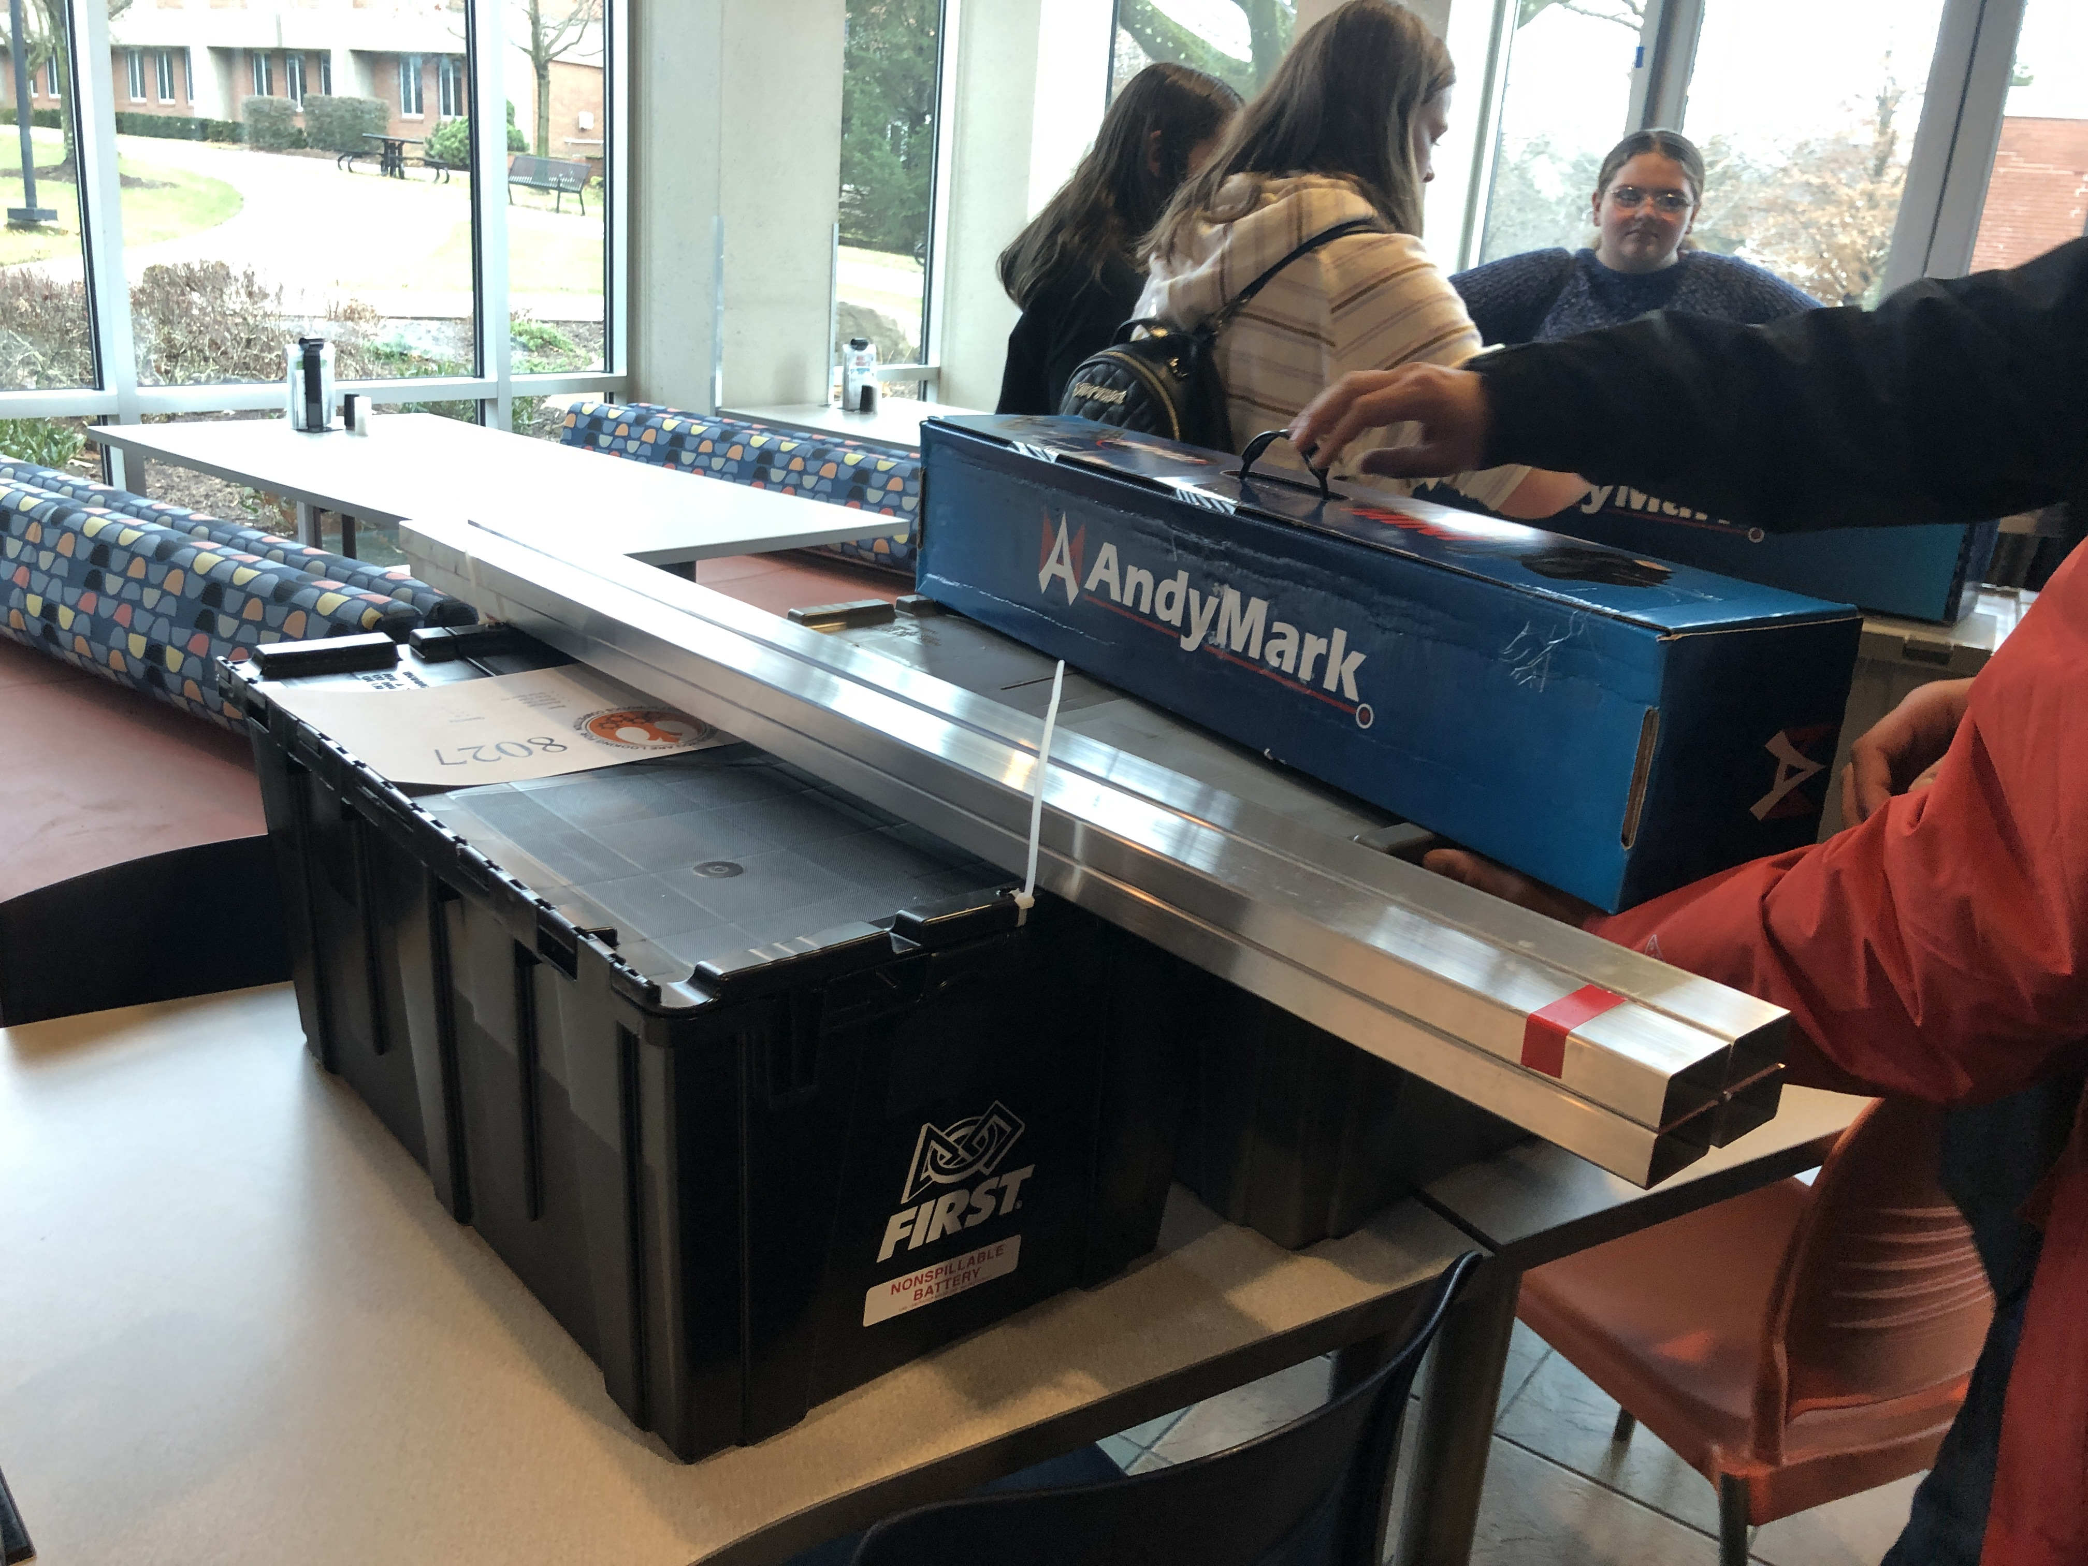
About the Kit of Parts
Veterans may opt out of getting kit of parts drive base in exchange for Andy Mark credits. The deadline is usually early October.
[Rookie Tip] Rookies receive more material materials with their kit of parts (e.g. electronics, laptop) than a veteran team. Hence, your first event registration cost is $1000 more than a veteran team.
[Rookie Tip] Take a look at past years’ kit of parts to get an idea about what you will receive as part of registration. Some details vary from year to year but this will help you budget and avoid duplicate purchases. (e.g. https://www.firstinspires.org/sites/default/files/uploads/resource_library/frc/game-and-season-info/archive/2019/2019-kop.pdf).
Teams should also see the lesson on FIRST Choice to plan on what equipment is available as part of registration.

Slide 7
Step 5: Unrestricted Event Registration
Once all teams have had a chance to register, the system opens up for additional events at the end of October

Slide 8
Step 6: World Championship Registration
If your team qualifies for World Championships, you will receive an email within a few days of the completion of your event.
You have to register and make payment arrangements within 2 days.

Slide 9
Costs
Costs vary depending on if you compete in a Regional or in a District
There are also variations by District
Pricing Information and Payment Deadlines are available here: https://www.firstinspires.org/robotics/frc/pricing-and-payment

Slide 10
Useful Links
Event Registration:
https://info.firstinspires.org/hubfs/team-blasts/2020-event-registration-faq.pdf
Pricing and Payment:
https://www.firstinspires.org/robotics/frc/pricing-and-payment
Event Preference System:
https://www.firstinspires.org/sites/default/files/uploads/resource_library/frc/registration/event-preference-system-user-guide.pdf

Slide 11

Credits
This lesson was written by FRC 8027 for FRCTutorials.com
You can contact the author at team@droidsrobotics.org
More lessons for FIRST Robotics Competition are available at www.FRCtutorials.com
This work is licensed under a
Creative Commons Attribution-NonCommercial-ShareAlike 4.0 International License.

